Slide 1
Ing. Richard Grom
Sales consultant - Slovakia
richard.grom@rtbhouse.com
+421 918 542 353

Slide 2
RTB Technológia

Slide 3
Ako RTB funguje
AdExchange
Aučkná platforma
SSP (Supply Side Platforms)
Publisher ponúkajúci na predaj svoj reklamný priestor v aukčnom modely
DSP (Demand Side Platforms)
Platforma umožňujúca účasť na aukcií
Nákup reklamy
Real – Time – Bidding
Technológia pre správu online aukcie

Slide 4
Personalizovaný retargeting

Slide 5
Personalizovaný retargeting
Krok za krokom
Krok 1. Užívateľ navštívi stránku a prezerá si produkty.

Slide 6
Personalizovaný retargeting
Krok za krokom
Krok 2. Užívateľ opúšťa stránku bez vykonania nákupu!

Slide 7
Personalizovaný retargeting
Krok za krokom
Krok 3. Užívateľ navštivy stránku v rámci RTB House platformy a vidí reklamný banner s personalizovanou správou.

Slide 8
Personalizovaný retargeting
Krok za krokom
Krok 4. Uživateľ klikne na banner a vráti sa späť na produkt, ktorý sledoval naposledy v danom e-shope!

Slide 9
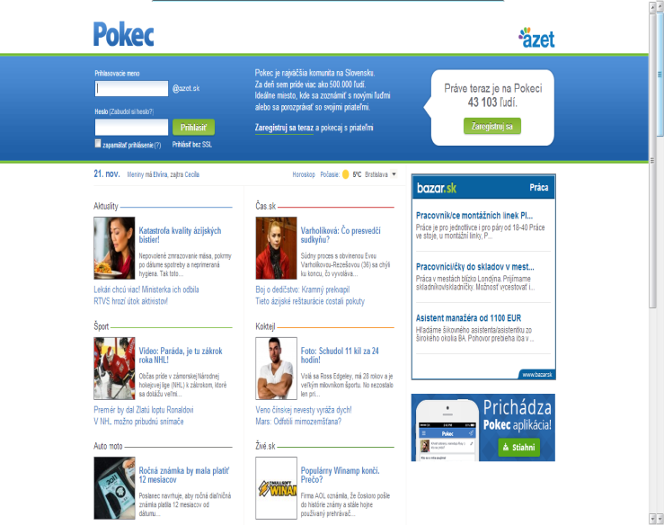
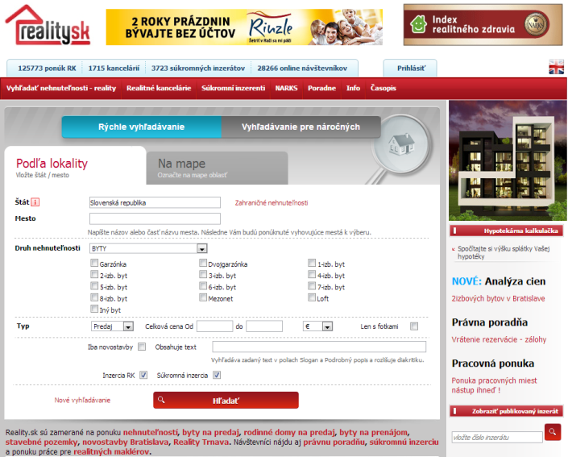
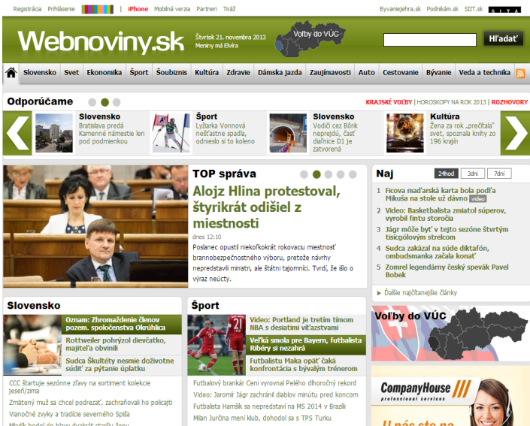

Slide 10
Segmentácia užívateľov:
- Visitors
- Shoppers
- Buyers

Slide 11
Case Study – Electronics in Turkey (CPS)
Campaign results for September 2013:
75 888 clicks
849 Post-Click conversions
Average campaign CTR: 0,47%
Sales value: over 250 000 Euro
Average cost of sale: 2%
Campaign results for 3Q 2013:
193 094 clicks
2038 Post-Click conversions
Average campaign CTR: 0,48%
Sales value: over 540 000 Euro
Average cost of sale: 2%

Slide 12
Case Study – Fashion in Russia (CPS)
Campaign results for September 2013:
9 236 clicks
478 Post-Click conversions
Average campaign CTR: 0,47%
Sales value: circa 30 000 Euro
Average cost of sale: 12%
Campaign results for 3Q 2013:
21 514 clicks
1 062 Post-Click conversions
Average campaign CTR: 0,7%
Sales value: circa 67 000 Euro
Average cost of sale: 12%

Slide 13
Case Study - Travel Agency in Poland (CPS)
Campaign results for September 2013:
11 621 clicks
45 Post-Click conversions
Average campaign CTR: 0,59%
Sales value: over 50 000 Euro
Average cost of sale: circa 3%
Campaign results 3Q 2013:
56 966 clicks
225 Post-Click conversions
Average campaign CTR: 0,52%
Sales value: over 275 000 Euro
Average cost of sale: circa 3%

Slide 14
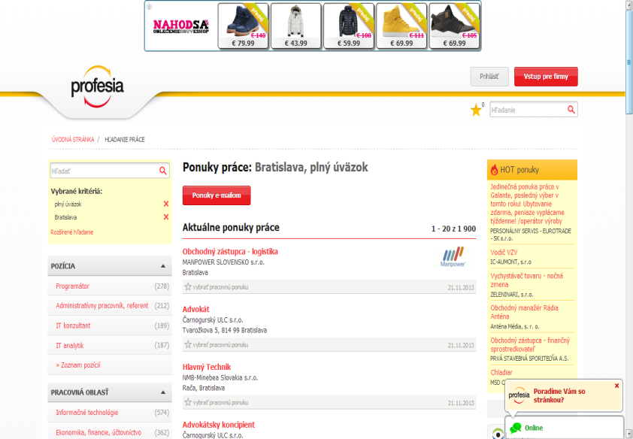
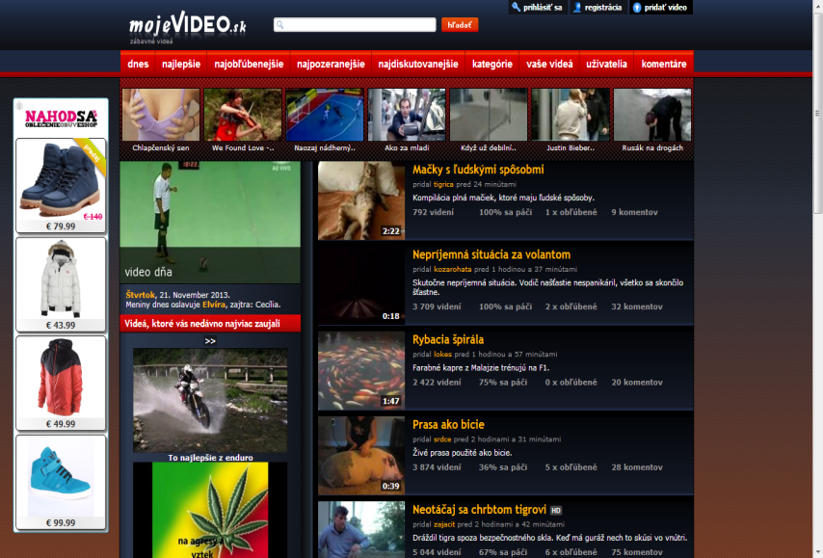
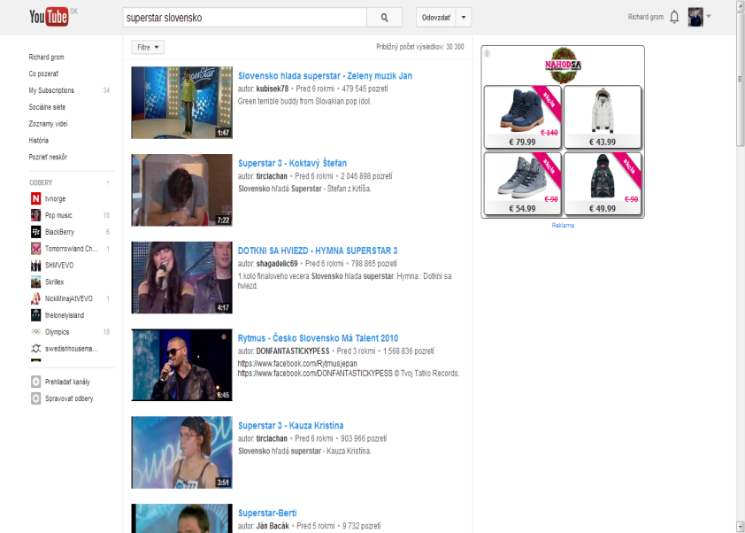
Case Study – Nahodsa.sk (CPS)
Campaign results for October 2013:
16 959 clicks
203 Post-Click conversions
Average campaign CTR: 0,65%
Sales value: over 13 000 Euro
Average cost of sale: 10%
Conversions till 1 day: 60%

Slide 15
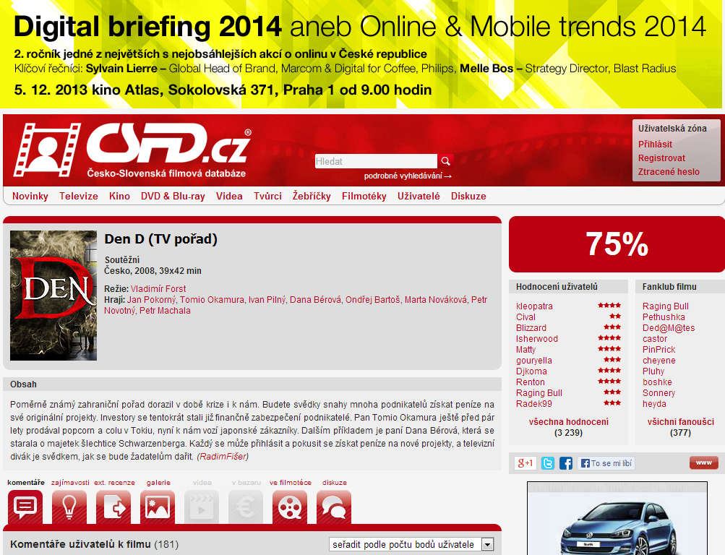
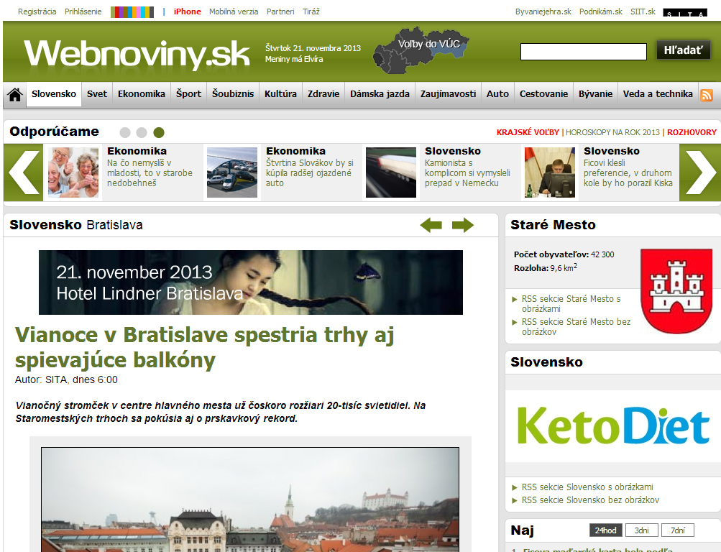
Case Study – ZlavaDna.sk (CPC)
Campaign results for 1-20 November 2013:
11 550 clicks
621 Post-click conversions
Average campaign CTR: 0,3%
Average campaign PCCR rate: 5,38%
Sales value: circa 17 000 Euro
Average cost of sale: circa 6,2%

Slide 16
Vybraný regionálny klienti

Slide 17
Ing. Richard Grom
Sales Consultant - Slovakia
richard.grom@rtbhouse.com
+421 918 542 353

